Slide 1
Fossil dating
Year 10 Pre-ATAR Science

Slide 2
Review questions
Name three index fossils.
Which time period is longest out of eon, era and epoch?
Which was most recent out of Cretaceous, Holocene, Jurassic, and Hadean?
What was the Cambrian Explosion?
What event signified the end of the Paleozoic era?

Slide 3
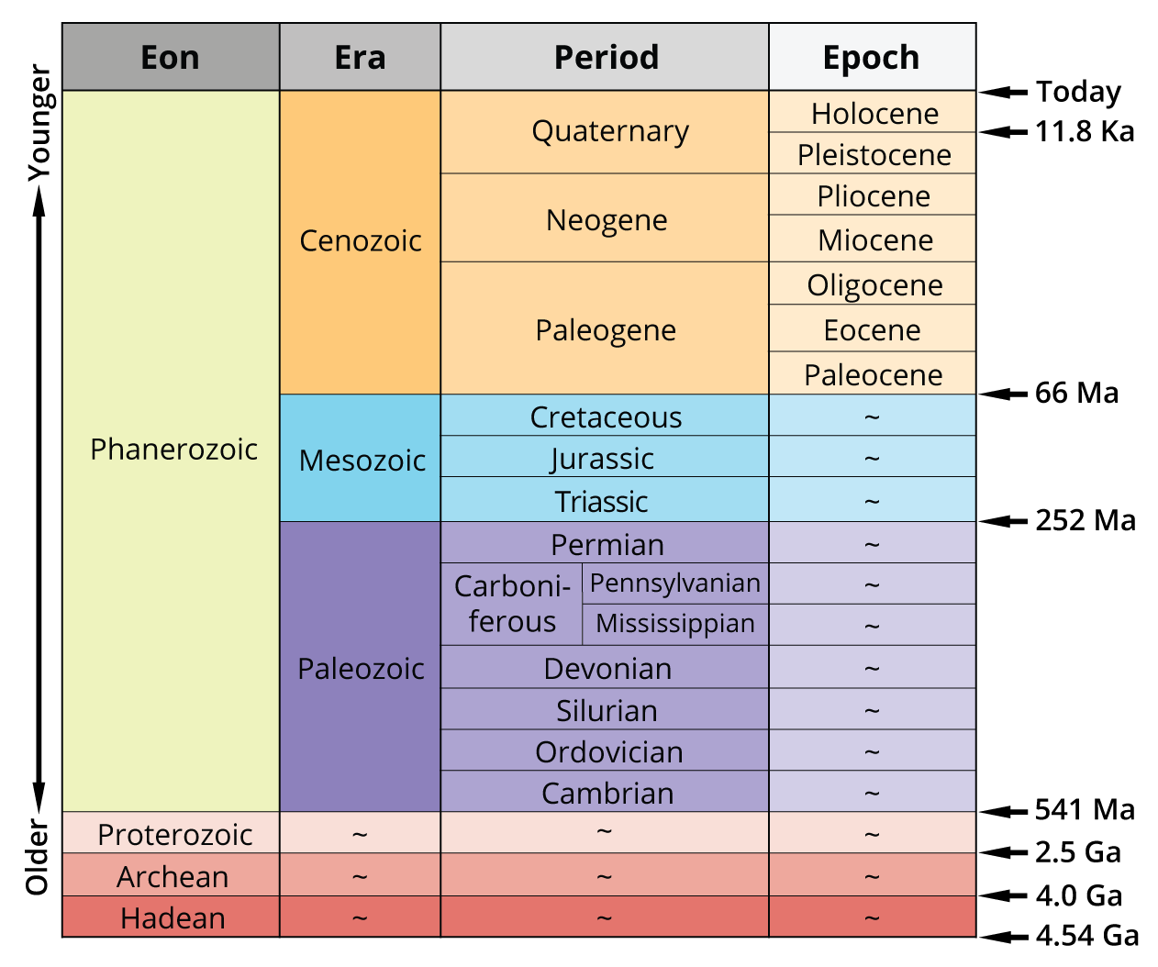

Slide 4
Learning Intentions
The theory of evolution by natural selection explains the diversity of living things and is supported by a range of scientific evidence

Slide 5
Success criteria
Explain the difference between relative and radioisotopic dating
Give examples of radioisotopes that are used in dating fossils and rock strata.
Explain the limitations of C-14 as a radioisotopic dating technique
Use calculations to estimate fossil ages using half life calculations.

Slide 6
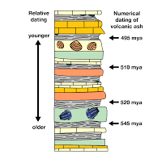
Relative dating
Relative dating is the science of determining the relative order of past events, without necessarily determining their absolute age.
In geology, rock or superficial deposits, fossils and lithologies can be used to correlate one stratigraphic column with another.

Slide 7
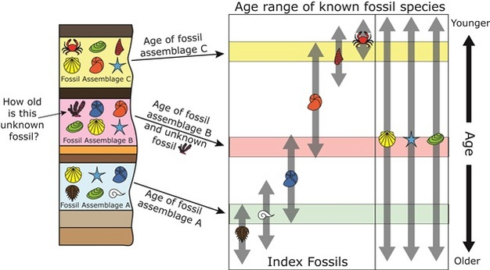

Slide 8
Radioisotopic dating
Radiocarbon dating (also known as carbon dating or carbon-14 dating) is a technique for determining the age of an organic object by utilising the properties of radiocarbon, a radioactive isotope of carbon.

Slide 9
Carbon Dating
The amount of ¹⁴C in a sample from a dead plant or animal, such as a piece of wood or a fragment of bone, provides information that can be used to determine when the animal or plant died. Because the half-life of ¹⁴C is about 5,730 years, the oldest dates that can be reliably measured by this process date to approximately 50,000 years ago, though special preparation methods occasionally allow accurate analysis of older samples.

Slide 10
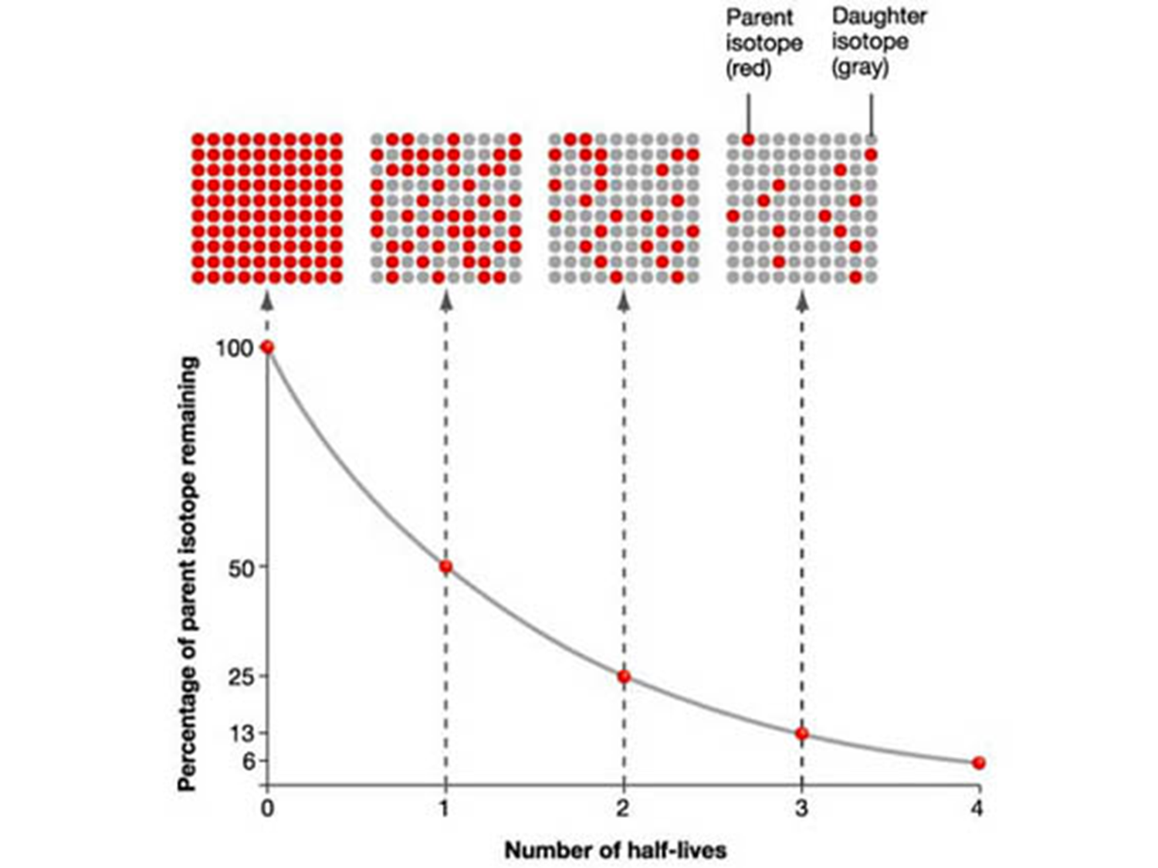
Where N is number or mass of original atoms remaining in the sample,
N₀ is original number or mass of these atoms,
n is the number of half-lives which have passed

Slide 11
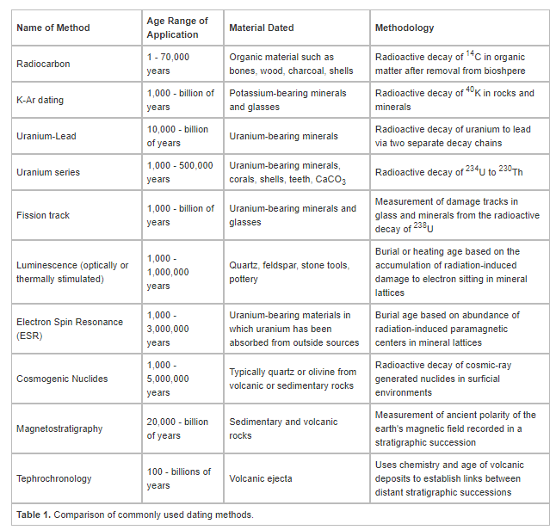
Other methods of dating

Slide 12
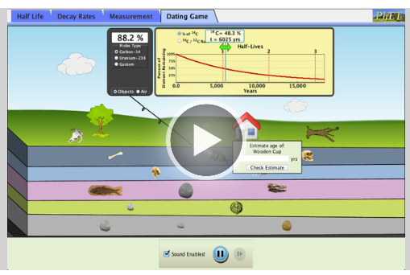

Slide 13
Success criteria
Explain the difference between relative and radioisotopic dating
Give examples of radioisotopes that are used in dating fossils and rock strata.
Explain the limitations of C-14 as a radioisotopic dating technique
Use calculations to estimate fossil ages using half life calculations.

